Slide 1
Online Learning 2
Francisco Javier Pinedo Cruz
A01551344

Slide 2
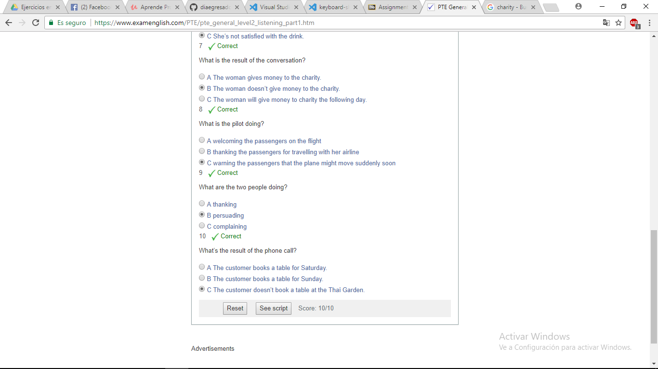
Exercise 1

Slide 3
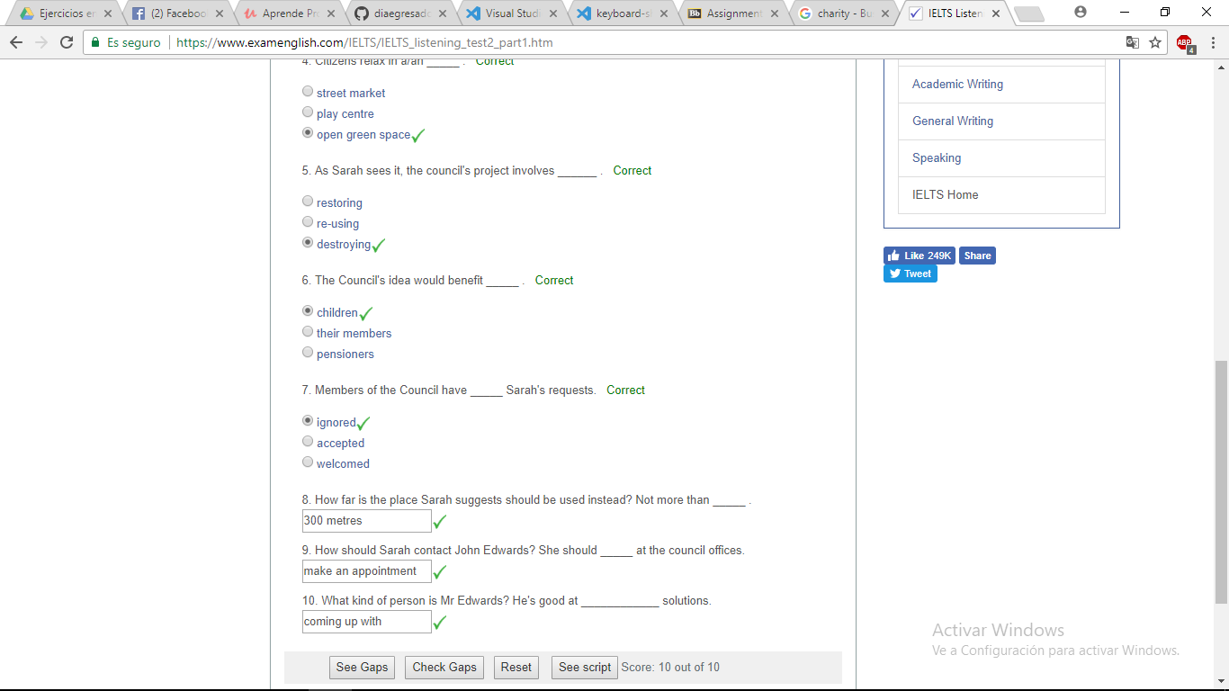
Exercise 2

Slide 4
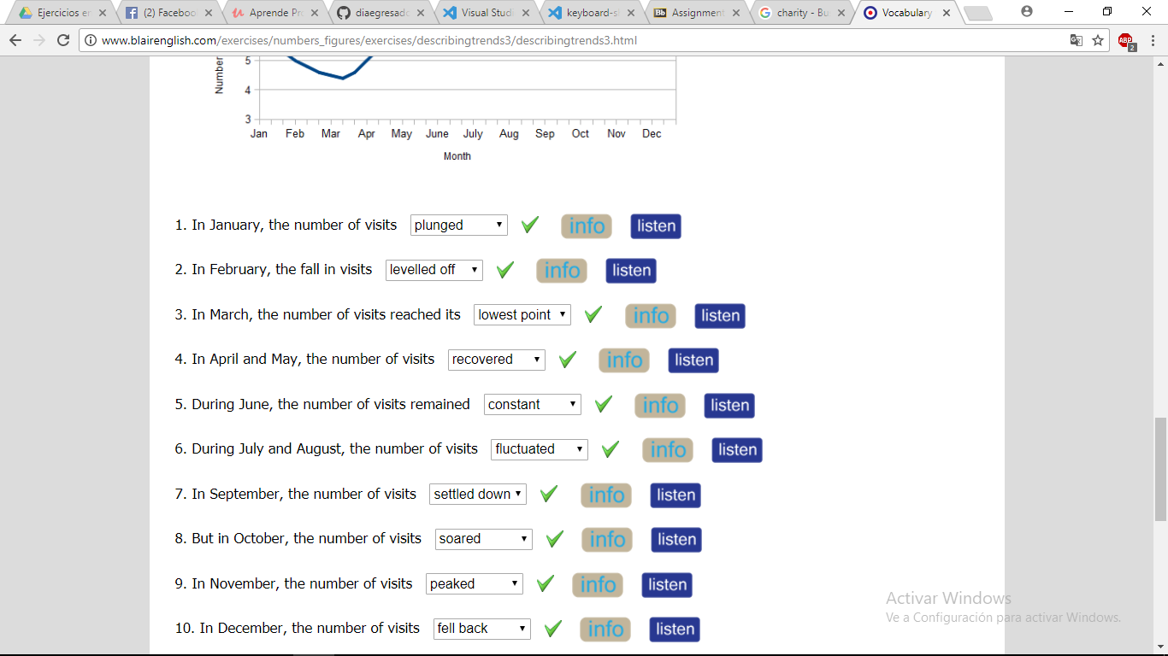
Exercise 3

Slide 5
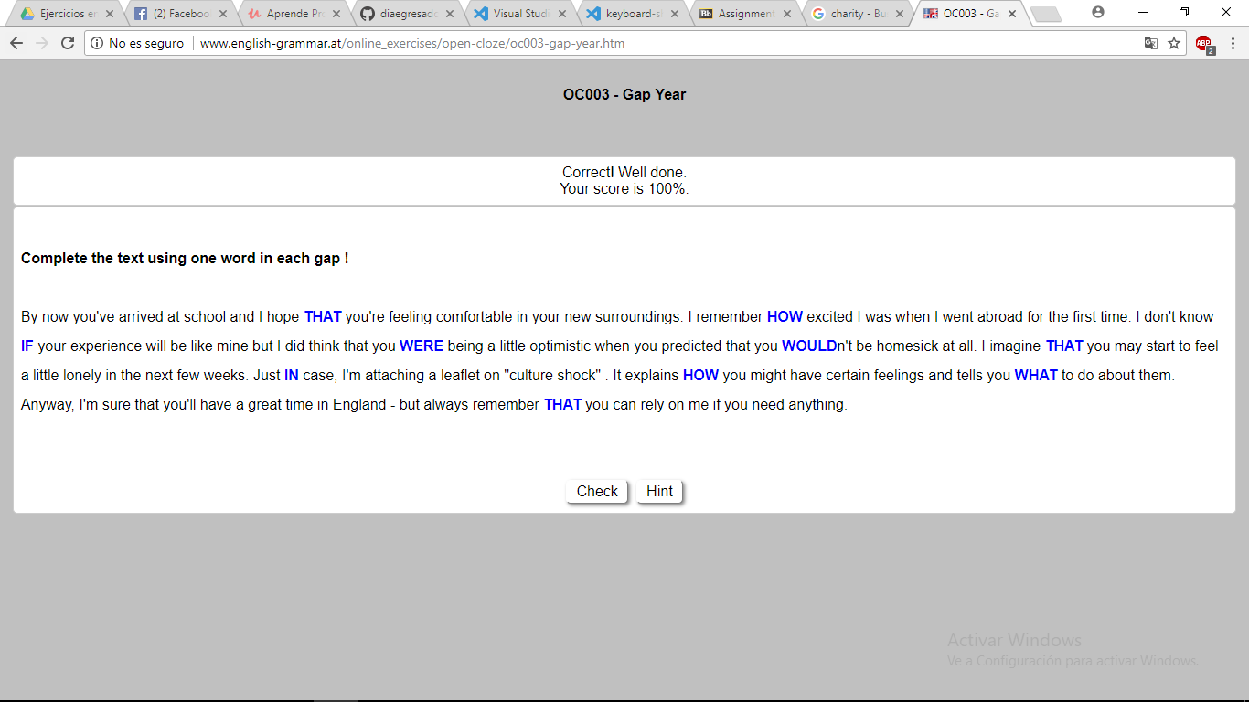
Exercise 4

Slide 6
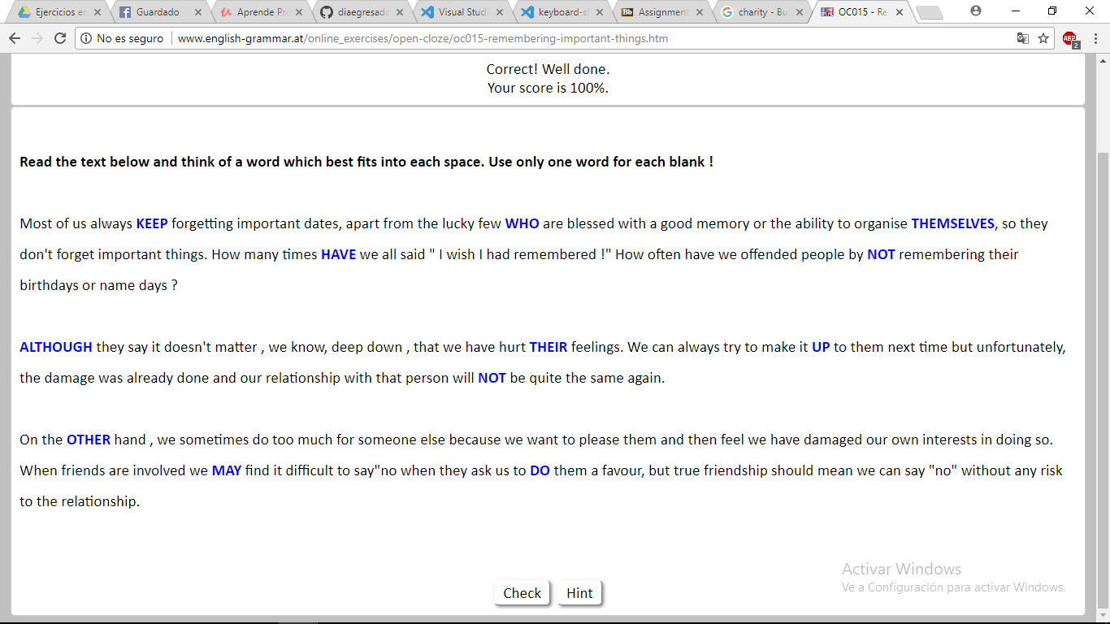
Exercise 5

Slide 7
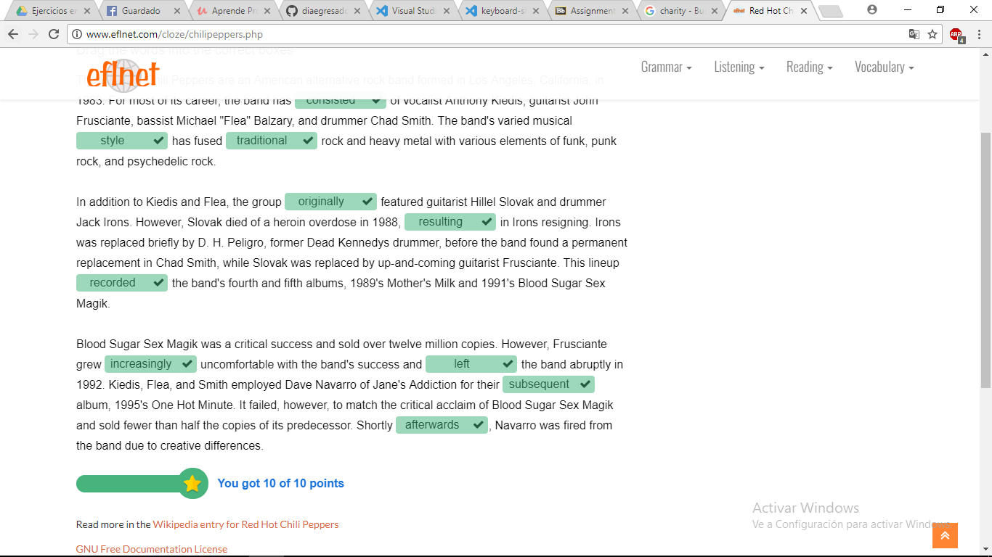
Exercise 6

Slide 8
Exercise 7

